Slide 1
Elliptic Curve Cryptography(ECC)
Presented By:
Sunny keshri (1SI14IS054)

Slide 2
Agenda
Introduction to Elliptic Curve Cryptography(ECC)
Mathematics in ECC
How it works
Applications
Strengths
Weaknesses

Slide 3
Introduction to ECC
Originally introduced in 1985 by Neal Koblitz and Victor Miller
Asymmetric/public key method
Trap door function
Similar to RSA in application but more complex math is used
Basic Elliptic Curve(EC) equation:y^2=x^3+ax+b
Any non-vertical line will intersect the curve in 3 places at most

Slide 4
Mathematics in ECC
Point addition
The two point P(x1, y1) and Q(x2, y2) are distinct. P + Q = R(x3, y3) is given by the following calculation. Figure 1(a) shows graphical representation of Point Addition operation.
Point Doubling
The two point P(x1, y1) and Q(x1, y1) overlap. P + Q = R(x3, y3) is given by the following calculation. Figure 1(b) shows graphical representation of Point Doubling operation.

Slide 5
Mathematics in ECC over finite field(contd.)
Point multiplication
Let P be any point on the elliptic curve. Multiplication operation over P is defined by the repeated addition. k P = P + P + P + · · · + k times.
Point at infinity
If x1 = x2 and y1 = y2 = 0 or x1 = x2 and y1 = − y2, the points is said to intersect at infinity denoted by O. Figure 1(c) and 1(d) shows graphical representation of Point at Infinity.

Slide 6
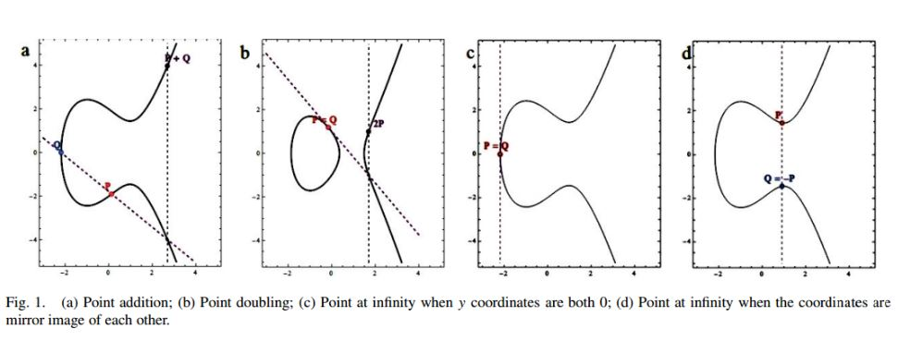
Graphs

Slide 7
Elliptic Curve Cryptography
Since ECC is a public key cryptography, we require a public key and a private key.
Consider Alice and Bob are the two communicating parties. They agree upon a common Elliptic curve equation and a generator G.
Let Alice and Bob private keys be n A and n B respectively. Alice and Bob public keys are given by Pa= n AG Pb = n BG

Slide 8
ECC(contd.)
If Alice want to send a message ‘ Pm’ to Bob, Alice uses Bob’s public key to encrypt the message.
The cipher text is given by Pc= {kG, Pm + k Pb}
where ‘k’ is a random integer. The random ‘k’ make sure that even for a same message the cipher text generated is different each time.
Bob decrypts the message by subtracting the coordinate of ‘kG’ multiplied by nB from ‘ Pm + k Pb’. Pm= { Pm + k Pb − nBkG}

Slide 9
ECC(contd.)
Here multiplied does not mean simple multiplication that we do in algebra, rather it is multiple addition of points using the point addition method stated above in point multiplication. As the multiplier nB is the secret key of Bob,only Bob can decrypt the message sent by Alice.

Slide 10
Proposed Algorithm
The communicating parties agrees upon an elliptic curve equation
y^2 = x ^3 + ax + b mod p
with the generator ‘G’ and makes the public keys ‘ Pa’ and ‘ Pb’ known to all and private keys ‘n A’ and ‘nB’ are kept secret.
We group the ASCII values of the characters and perform cryptographic operation on the group. The size of each group is given by
group size = Length[IntegerDigits[ p, 65536]] − 1
Each group is converted into big integer values. We pair up the big integer value and use it as ‘ Pm’ in the ECC operation.

Slide 11
Encryption
Obtain the text to be send.
Convert to its corresponding ASCII values.
Partition the ASCII value as Partition[ASCII values, group size, groupsize, 1, {}] This operation group the ASCII values with size given by group size.
Each group obtained from the above step is converted into big integer values taking base as 65536.
FromDigits[Group of ASCII values, 65536]

Slide 12
Encryption(contd.)
Pad with 32 to the end of the list from the above step if the count of the above list is odd, to make it even for performing complete pairing. Each single pair will be an input to the ECC system as ‘ Pm’. We pad with 32 because 32 represents blank space in ASCII code.
Select random k value, k = Random value with range 1 to n− 1. Compute kG and k Pb using Point multiplication operation.
Compute Pm + k Pb using point addition or point doubling as required.
Send Pc = {kG, Pm + k Pb} as cipher text to the receiver side.

Slide 13
Decryption
Get the cipher text Pc.
Get the left part kG and right part Pm + k Pb of the Pc separately.
Multiply with nB to the left part and subtract it from the right part to get Pm. { Pm + k Pb} − nBkG = Pm since Pb = nBG. Subtraction operation can be converted to addition by multiplying with −1 to the y coordinate. This operation can be justified with point addition operation. In point addition we used to get the mirror image point over the x-axis. Example:- {97, 24} = {97, −24}.

Slide 14
Decryption(contd.)
The above operation will yield the big integer value which is formed by combining group of ASCII values. Convert it back to list of ASCII values.
IntegerDigits[big integer, 65536]
IntegerDigits [n, b] in Mathematica provides a list of the base b digits in the integer n. IntegerDigits and FromDigits function are inverse of each other, so the ASCII values are preserved during encryption and decryption.
Convert the list of ASCII values to its corresponding characters.

Slide 15
Applications
Encryption
Digital signatures
Pseudo random number generators
E-commerce
Smart cards
Digital money
Secure communications

Slide 16
Security Analysis
Key space
Cipher text only attack
Known plaintext attack

Slide 17
Strengths
Shorter Key Length
Lesser Computational Complexity
Low Power Requirement
More Secure

Slide 18
Weaknesses
Complicated to implement
Still has some patent problems
ECC is much more efficient than RSA for signature generation and decryption, but it's still much slower than symmetric algorithms;

Slide 19
THANK YOU

